Slide 1
Podcasting: sharing your museum’s story
Kirsten Murray
Director, Brisbane’s Living Heritage Network
Community Educator Coordinator, SCLQ

Slide 2
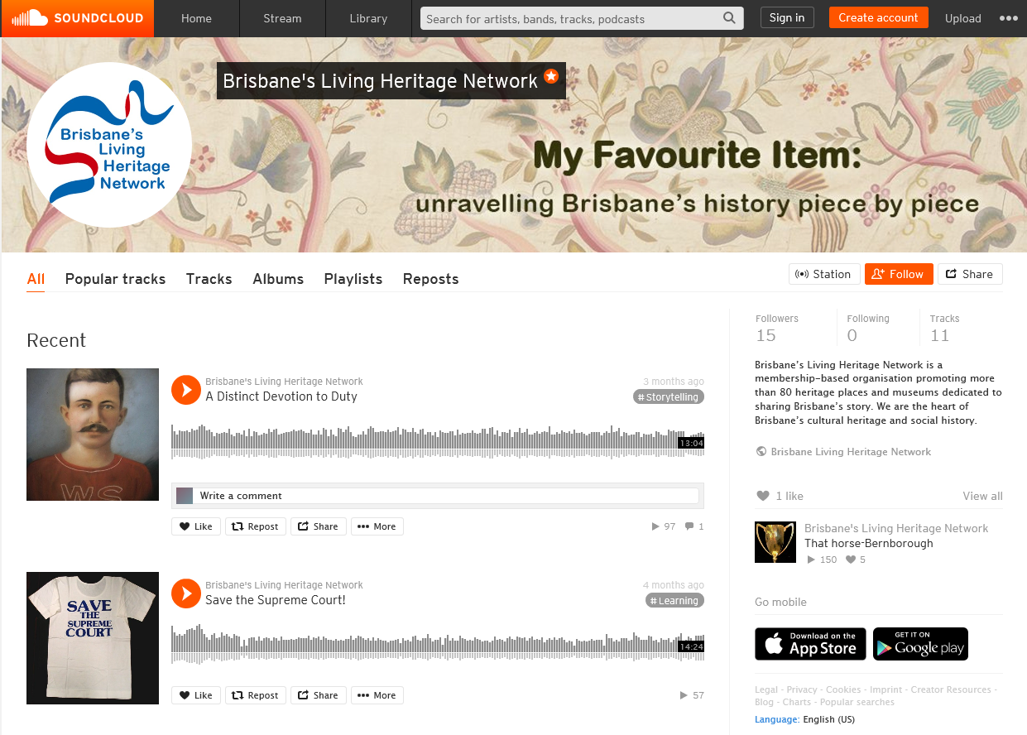

Slide 3
‘…we are now well into the era of the podcast.’
Notes:
Maria Trujillo, ‘The museum podcast: sparking meaningful connections’, Art Critique. 31 December 2019, https://www.art-critique.com/en/2019/12/museum-podcasts-sparking-meaningful-connections/.

Slide 4
Australians listened to a podcast in the last week.
68% of these consumed at least 4 episodes.
15%
Podcast audiences have grown by
70% want to be informed
75% want to learn
70%
79% want to be entertained
Notes:
Triton Digital, ‘The Australian podcast data kit’, Triton Digital. 2019, https://tritondigitalv3.blob.core.windows.net/media/Default/Resources/Podcast%20Data%20Kit%20Australia%202019.pdf.ABC, ‘ABC’s 2019 Podcast Survey’, ABC. 3 October 2019, https://about.abc.net.au/media-room/abc-podcast-survey-reveals-just-how-engaged-podcast-audiences-are/.
Roy Morgan, ‘Podcasts growing in popularity in Australia’, Roy Morgan. 22 July 2019, http://www.roymorgan.com/findings/8056-podcast-listeners-australia-march-2019-201907190703#:~:text=Average%20interviews%20per%20year%20n,million%20just%20four%20years%20ago.

Slide 5
‘…one of the reasons podcasts are so popular, is that audio is such a powerful storytelling vehicle. And museums have so many great stories to tell.’
Notes:
Eric, ‘Let’s hear it for audio!’, Cuberis. 30 January 2019, https://cuberis.com/lets-hear-it-for-audio/.

Slide 6
What collection, item, person, institution, theme do you want to explore?
What makes your museum unique or one-of-a-kind?
What great stories do you want to tell?
What current event or topic do you want to raise awareness of?

Slide 7
Who is your target audience?
What will you name it?
What format will you use?
How often will you post?
What is your plan?
What visuals will you use?

Slide 8
Our podcasting process
1
Script

Slide 9
INTRODUCTION
[MUSIC IN BACKGROUND]
When you last visited a local museum, art gallery, library or heritage place did you ever wonder what the curator would choose as their favourite item? Would it be a photograph, a letter, a piece of art, a book or an object? Welcome to My favourite item, unraveling Brisbane’s history piece by piece, a podcast bought to you by Brisbane’s Living Heritage Network. In each episode join me, Kirsten Murray, as I step inside a different Brisbane based heritage place or museum to learn more about this city’s rich and unique history as I ask each guest to choose just one item that shares a story about Brisbane that they love.
[MUSIC INCREASE VOLUME, MUSIC FADE OUT]

Slide 10
[INTERVIEW]
[HORSE RACE SOUND]
In this episode we are joined by Peter Howard, President, Thoroughbred Racing History Association. The Association has an archive housed at Doomben racecourse where we are today and a museum at Eagle Farm. Hi Peter, thanks for joining us!
We are going to start this episode by talking about the item you have selected. Peter, what are we standing in front of?
But, every item has a story. To fully appreciate this beautiful trophy, we need to start at the beginning. Peter, what are we looking at here?

Slide 11
[CONCLUSION]
[FADE IN MUSIC, SITS IN BACKGROUND]
Thank-you for listening to My favourite item, unraveling Brisbane’s history piece by piece. We hope you enjoyed discovering more about Peter’s favourite item- if you want to learn more, how can people visit you Peter? [PETER TO ANSWER] You can also find out more about our organisation by visiting our website, blhn.org. Like this podcast or do you know something more about this item? Perhaps you or someone in your family saw Bernborough ride? Think about leaving a comment, subscribing or sharing this podcast on your social media platforms. What will be the next favourite item? Tune into the next episode to find out!
[INCREASE MUSIC VOLUME, FADE OUT MUSIC]

Slide 12
Our podcasting process
1
Script
2
Record

Slide 13
Have a drink.
Limit distractions (like mobile phones)
Check the volume.
Place microphones in a good position.
Don’t press pause (until you finish).
Take your time.
Record in a quiet, large room.

Slide 14
Our podcasting process
1
Script
2
Record
3
Edit

Slide 15
‘Editing is the most time-consuming part of podcasting.’
Notes:
Hannah Hethmon, ‘How to: super quick DIY podcasting for museums and other nonprofits closed by COVID-19, Medium. 18 March 2020,

Slide 16
Free editing software
Audacity*
GarageBand
Licenced music
options
Jamendo*
Audio Jungle
Story Blocks

Slide 17
Our podcasting process
1
4
Script
Publish
2
Record
3
Edit

Slide 18
Podcast hosts to try
Soundcloud*
Buzzsprout
PodBean
Libsyn
Podcast directories
Apple*
Spotify
Google

Slide 19
Our podcasting process
1
4
Script
Publish
2
5
Record
Market
3
Edit

Slide 20
‘Keep your expectations realistic.’
Notes:
Hannah Hethmon and Ian Elsner, ‘Podcasting in 2019: an introduction for museums’, MW19 Boston. 15 January 2019, http://mw19.mwconf.org/paper/podcasting-in-2019-an-introduction-for-museums/

Slide 21
‘Do the best you can in the time you have...aim for good not perfect.’
Notes:
Hannah Hethmon, ‘How to: super quick DIY podcasting for museums and other nonprofits closed by COVID-19, Medium. 18 March 2020, https://medium.com/@hannah_rfh/how-to-super-quick-diy-podcasting-for-museums-other-nonprofits-closed-by-covid-19-82f5e95691f6.

